Slide 1



GLOBAL SAFETY STAND DOWN 2023
“Step up for Safety”

Slide 2
Our Commitment to Safety
Our Safety Journey
Pillars of Our Safety Culture – Safety Policy
Pillars of Our Safety Culture – Life Saving Rules
Pillars of Our Safety Culture – Workplace Organization
Creating a Safety Culture
Safety Leadership

Slide 3
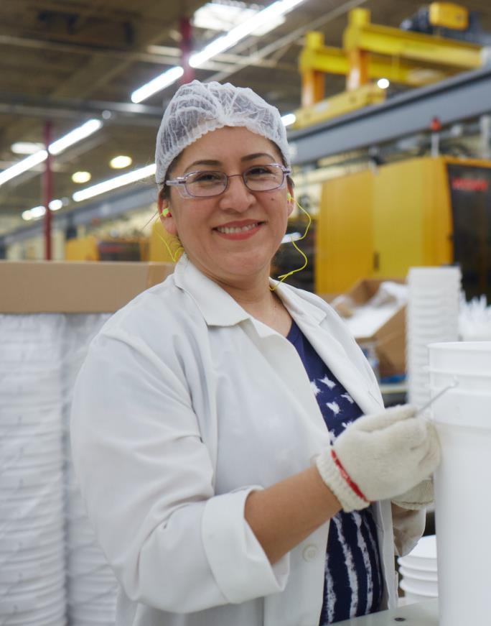
OUR COMMITMENT TO SAFETY AS A CORE VALUE
Nothing is worth getting injured over.
All injuries can be prevented.
Safety will be managed.
Safe behavior is a condition of employment for all employees.
“
“
As a Company, it is our ethical responsibility to ensure that each employee goes home safe, every day.
Safety is an important element in every decision we make.
– Mark Burgess, President and CEO
Notes:
At Mauser Packaging Solutions, we are all leaders when it comes to Safety. We all share equal responsibility for knowing and ability by our safety principles regardless of job, role or tenure.
We have a duty each and every day to remind ourselves of our core safety principles. Our core safety principles are:
Nothing is worth getting injured over.
All injuries can be prevented.
Safety will be managed.
Safe behavior is a condition of employment for all employees.

Slide 4
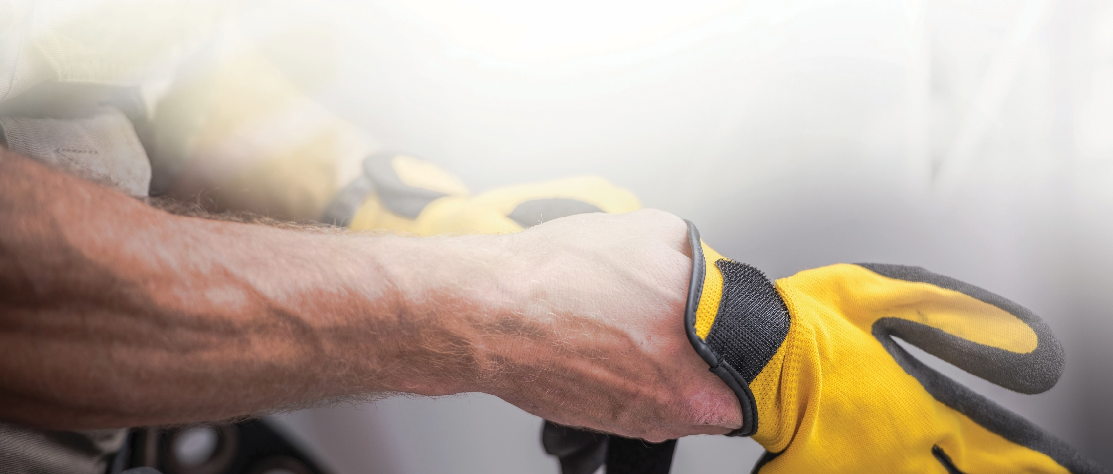
Current State
Notes:
To begin with, we will examine our current safety culture.

Slide 5

OUR SAFETY JOURNEY
GLOBAL SAFETY STAND DOWN 2023
Current Reduction from 2020
22.33%
TRIR
Total Recordable
Incident Rate
18.18%
LTIR
Lost Time
Incident Rate
Step up for Safety
5
Notes:
Overall, Mauser Packaging Solutions is making year over year improvement regarding safety based on both leading and lagging indicators. However, we still have life altering injuries happening in the workplace.

Slide 6
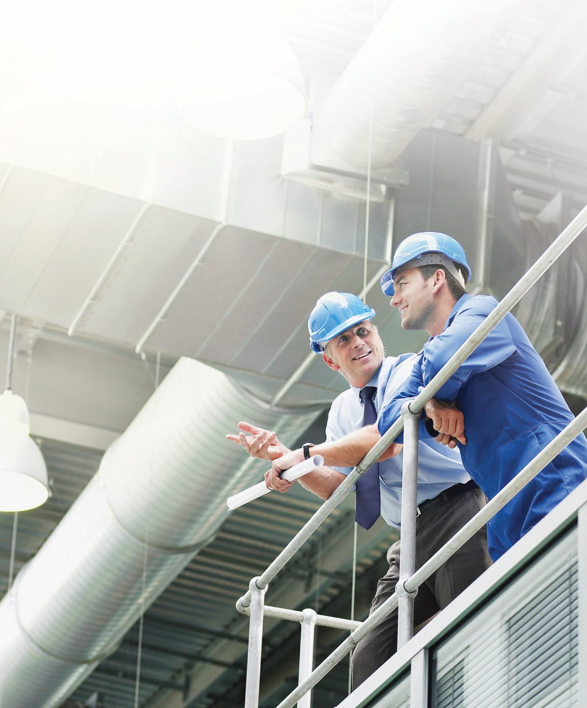
Corporate Investments in Safety
Investments in Infrastructure
Significant CAPEX investments made over the several years to directly improve the safety infrastructure in facilities.
Investments in Training
Additional focus and investment made into safety training programs including new hire training and Safety Engagement Workshop for Supervisors.
Notes:
On a corporate level, we are acting on our commitment to safety with investments in infrastructure, training and ???.
Over $XX of CAPEX investments made over the past X years that directly improve the safety infrastructure in facilities.
Additional focus and investment made into safety training programs including new hire training and Safety Engagement Workshop for Supervisors.

Slide 7
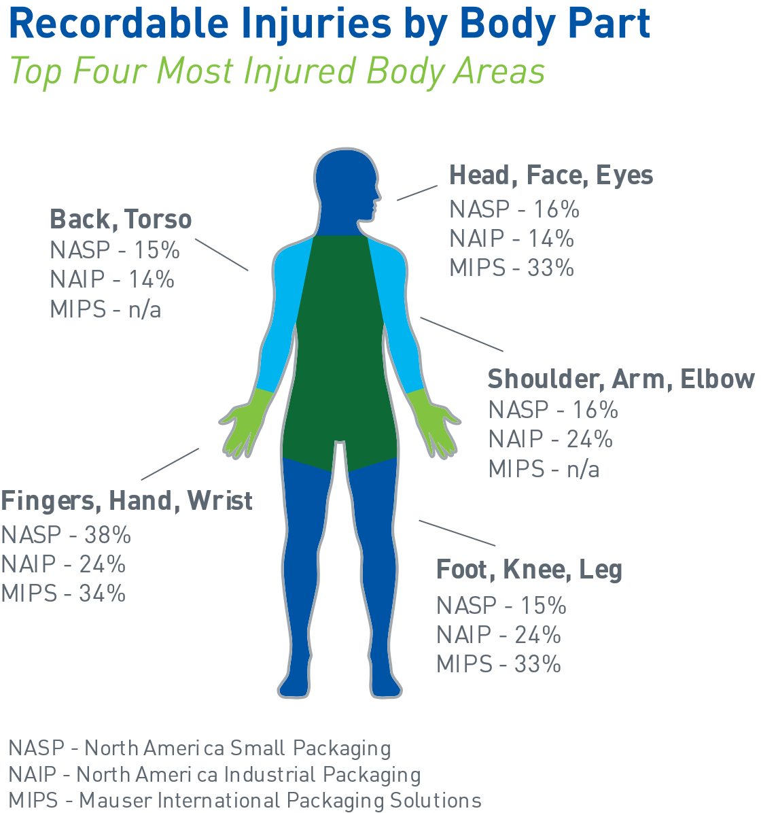
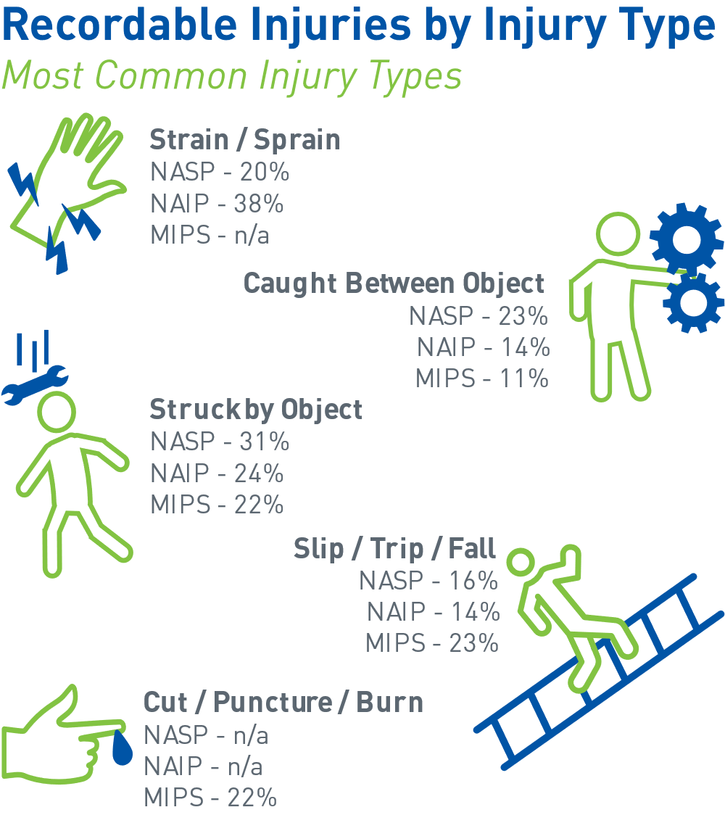
2023 QUARTER 1 INJURIES
GLOBAL SAFETY STAND DOWN 2023
We are improving in our safety journey, but employees are still experiencing life altering injuries.
Step up for Safety
7
Notes:
We are improving in our safety journey, but employees are still experiencing life altering injuries.

Slide 8
Mauser’s Safety Journey
GLOBAL SAFETY STAND DOWN 2023
Building a Safe Work Environment
The key elements to building and sustaining a safe work environment
Where we started
What we’re doing
Where we are
Government and Company Rules/Regulations
Engineering Controls
Leadership
In the past five years, Mauser has increased out commitment to OSHA regulations along with introducing our Life Saving Rules.
Focus: Compliance
Past few years, identifying high risk asset pinch points, designing and installing necessary machine guarding.
Focus: Elimination of Safety Hazards
Developing our leaders with the behaviors and actions to endorse a culture where employees are engaged in safety.
Focus: Commitment
Step up for Safety
8
Notes:
In the past five years, Mauser has been committed to ensuring compliance to OSHA regulations along with implementation of the Life Saving Rules to provide structure around the non-negotiable safety behaviors. We have also been investing significantly in engineering controls to provide the necessary infrastructure to protect employees from risk. But a true safety culture must begin with complete commitment from leadership in the company endorsing a culture where employees are engaged with safety. To take the next step in our safety journey, we are making a commitment at every level of the organization to prioritize safety above all other goals and objectives.

Slide 9
Pillars of our Safety Culture
Notes:
To begin with, we will examine our current safety culture.

Slide 10



THREE PILLARS OF OUR SAFETY CULTURE
COMMITTMENT
BEHAVIOR
ENVIRONMENT
Safety Policy
written statement of our commitment to safety
Life Saving Rules
guiding principles of how we practice our commitment to safety
Workplace Organization (5S)
creating a space where safe work can be practiced
Safety leaders at every level of the organization are needed
to develop and support a safety culture.
Notes:
Our Safety Culture is supported by three pillars
Our Global Health and Safety policy which is the written statement of our commitment to safety
The Life Saving Rules which are the guiding principles of how we practice out commitment to safety
And Workplace Organization which creates the physical space where safe work can be practiced. A safe work environment is created through many factors including machine guarding, automation, fall protection, ventilation, noise control, lighting and more, but organization created through 5S is one area where we all have ownership and responsibility.
Undergirding these three pillars are safety leaders that are needed at every level of the organization to develop and support a safety culture. A safety culture is nothing without people who comply with it and nurture it every day.
Over the next few slides we will take a look at each of these three pillars.

Slide 11
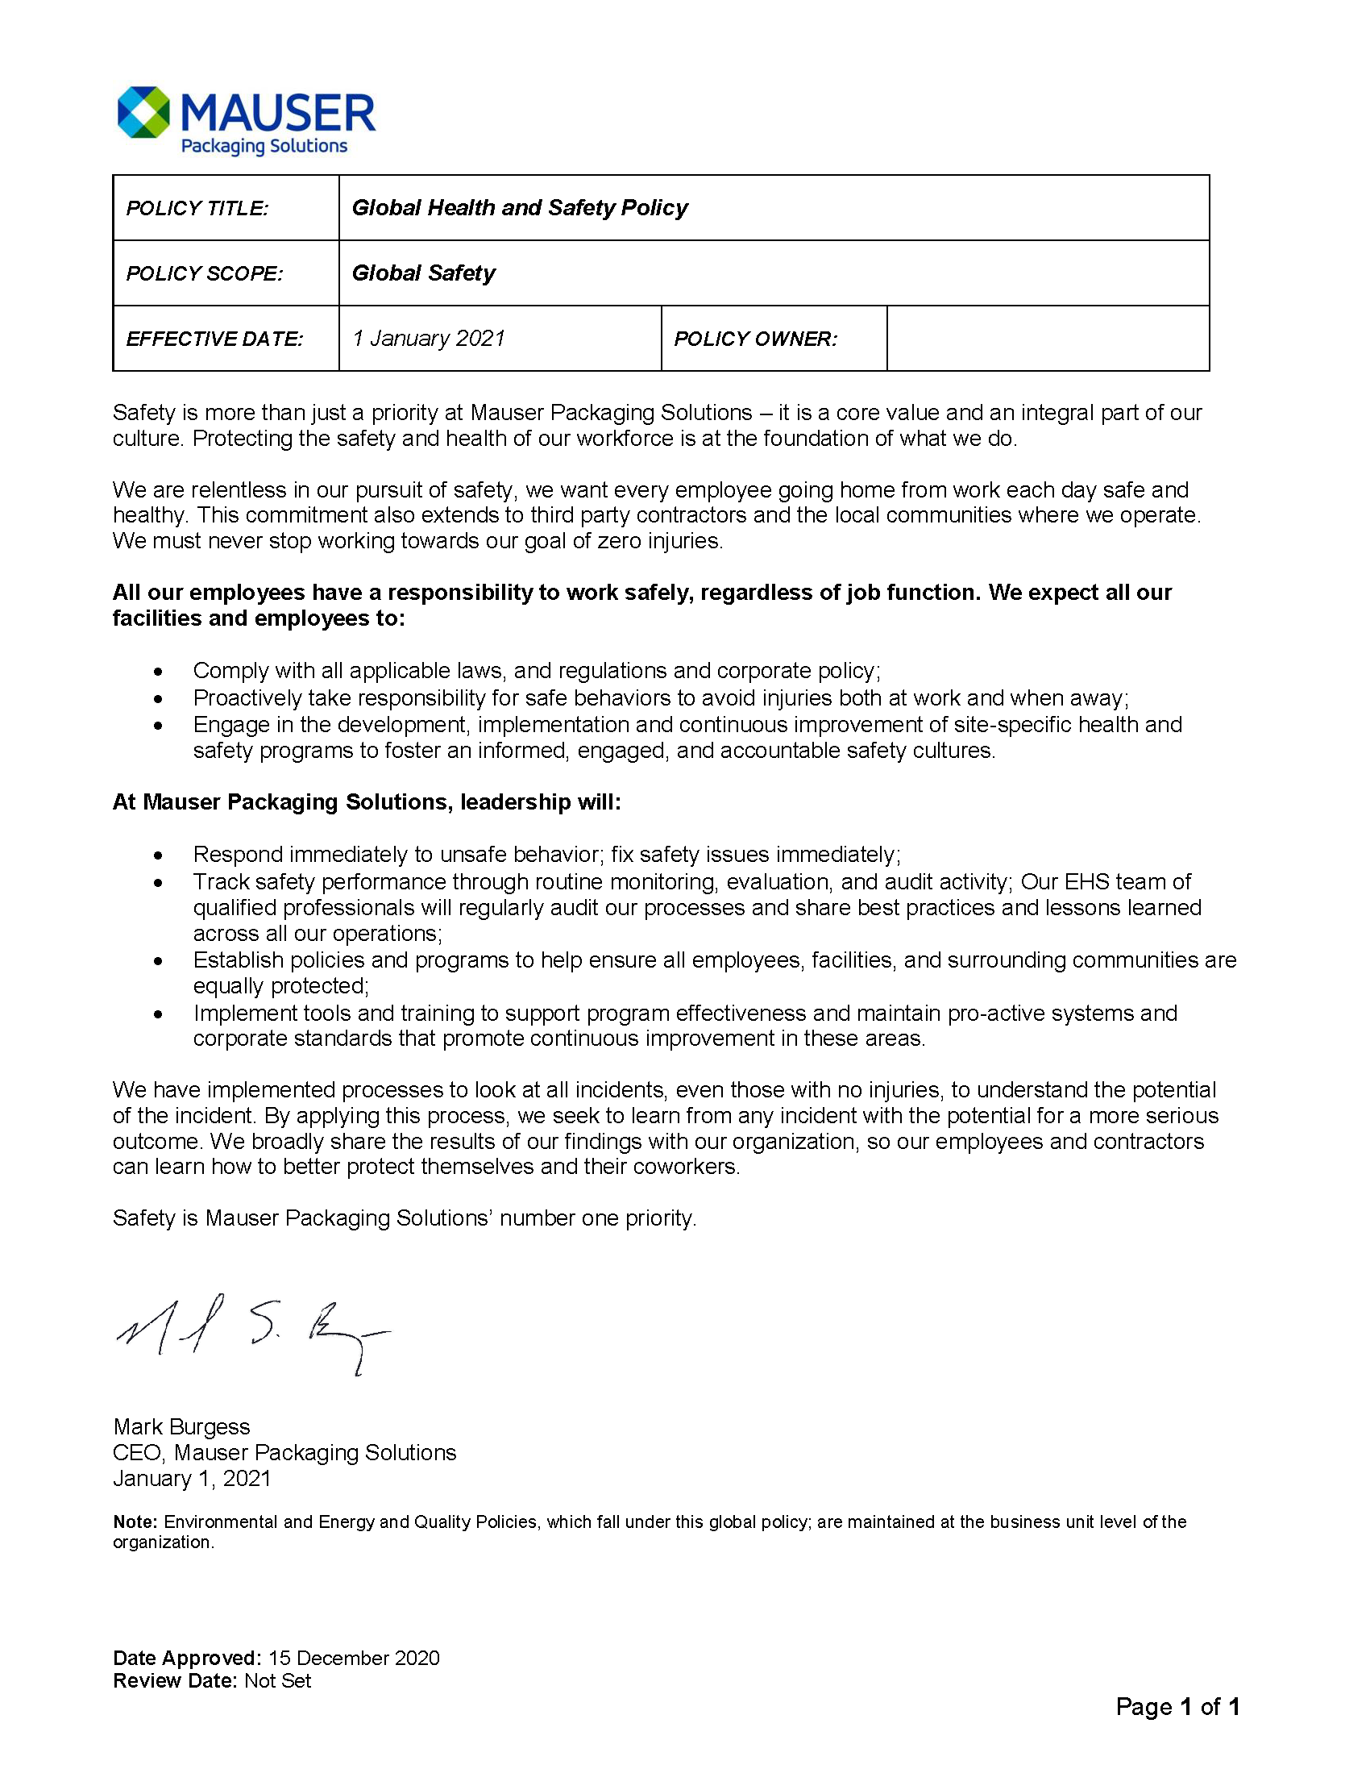
OUR SAFETY POLICY
Highlights of our policy:
Safety is a core value, not a priority. Relentless is our pursuit of safety.
Integral part of our culture.
Includes our community in which we work and contractors.
Our responsibility as Mauser employees along with our facilities.
Leadership’s accountability.
Incident processes, learning and evolving our safety.
Notes:
Our first pillar is our Global Health and Safety Policy.
This policy is a recognized written statement of our commitment to protect the health and safety of employees, those we work with and our community.
Highlights of our policy:
Safety is a core value, not a priority. Relentless is our pursuit of safety.
Integral part of our culture.
Includes our community in which we work and contractors.
Our responsibility as Mauser employees along with our facilities.
Leadership’s accountability.
Incident processes, learning and evolving our safety.
Employees can access our Global Health and Safety Policy on MauserNOW and on communication boards.

Slide 12
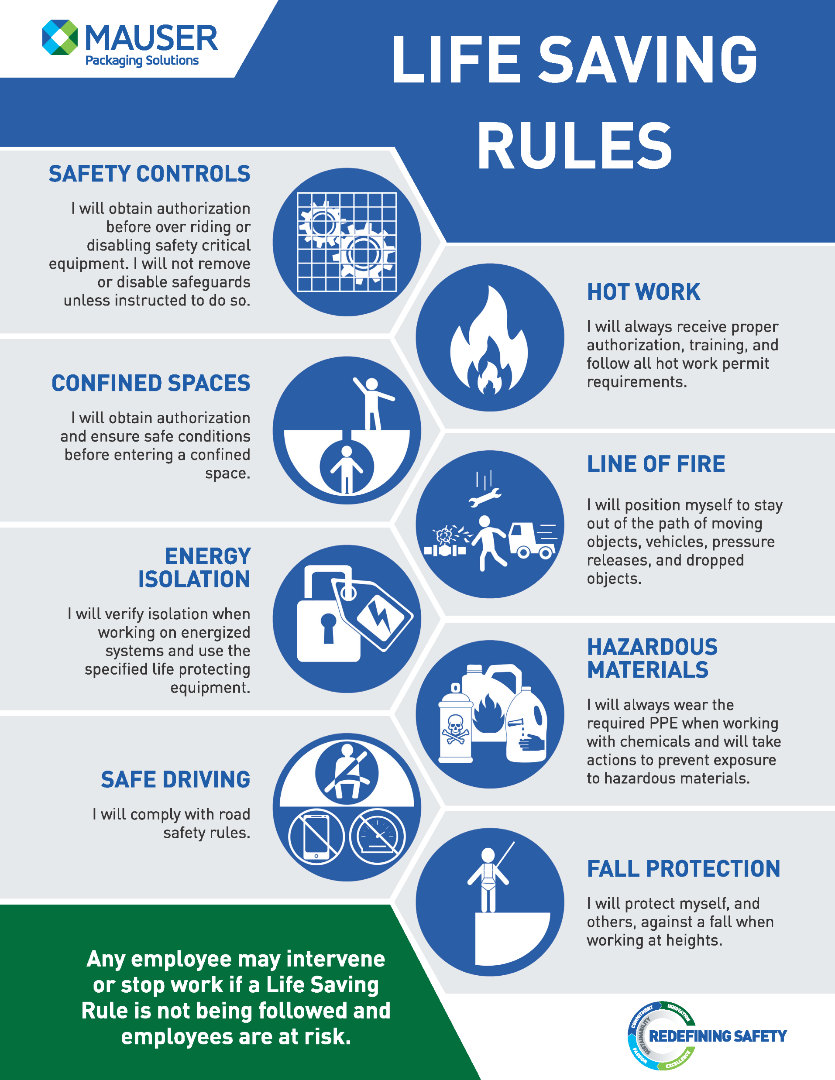
LIFE SAVING RULES
Life-Saving Rules (LSR) are key safety principles that address hazards specific to our operations protect us against serious injury or death.
Notes:
The second pillar is the Life Saving Rules which are key safety principles that address hazards specific to our operations protect us against serious injury or death.
If our policy is the statement of our commitment to safety, then the Life Saving Rules are the guiding principles of how we practice this commitment.
Implemented in 2020, the Life Saving Rules provide guidance for how all employees should act when dealing with hazardous situations or circumstances

Slide 13


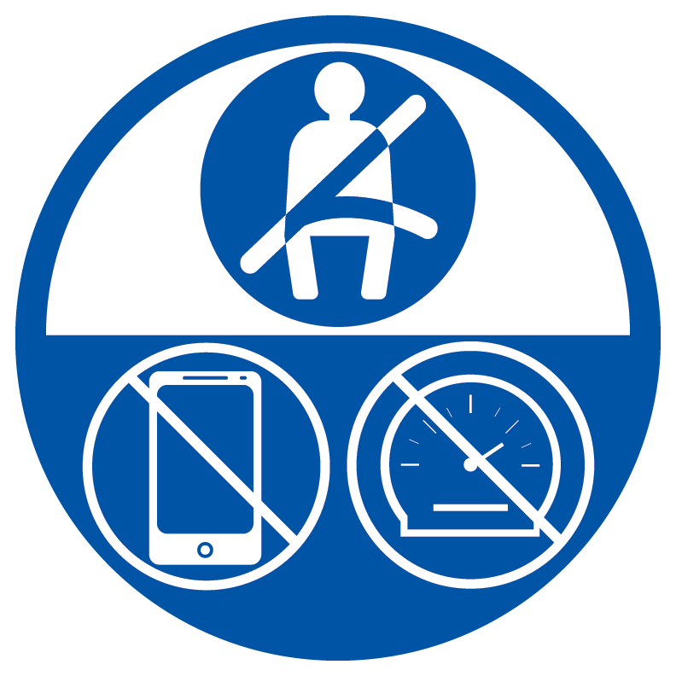


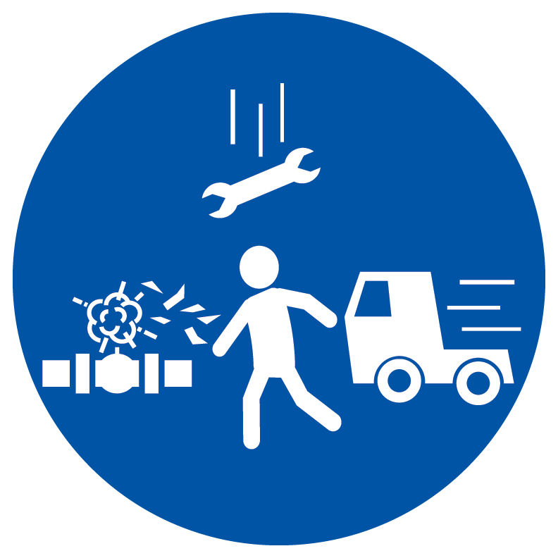
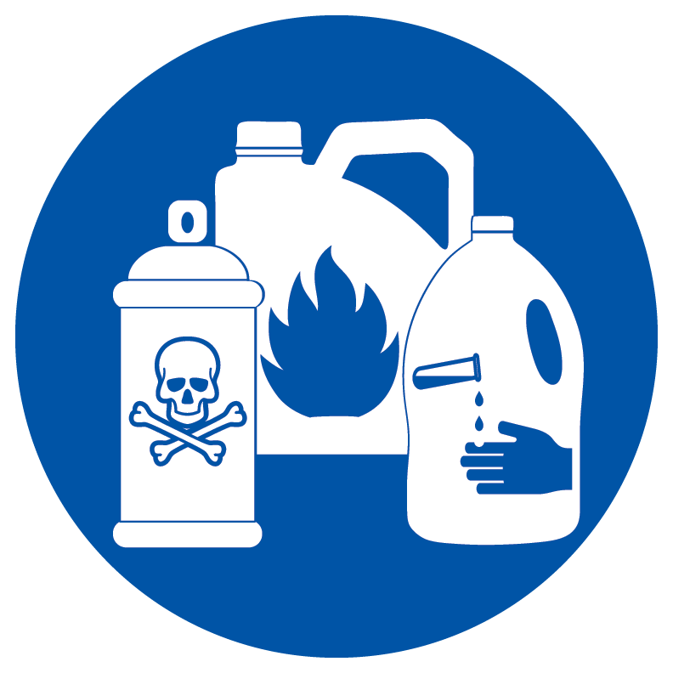

Active Commitment to the Life Saving Rules:
Education - It’s your responsibility to understand the Life Saving Rules. If unclear, ask!
Adherence to the Life Saving Rules – everyone is required to follow these rules regardless of position or job role
Risk Assessment -Before conducting a task, review the task against the Life Saving Rules.
Intervention - Everyone has the right to request an operation or activity be stopped if they believe a Life Saving Rule is not being followed and employees are at risk.
Actively Working together - If you see a fellow worker at risk, say something
Safety Controls
Confined Space
Safe Driving
Energy Isolation
Hot Work
Line of Fire
Hazardous Materials
Fall Protection
Notes:
Leaders have a responsibility to create an environment that enforces these rules, but every employee has a responsibility for demonstrating behaviors and actions that adhere to the Life Saving Rules.
An active commitment to the Life Saving Rules includes:
Education - It’s your responsibility to understand the Life Saving Rules. If unclear, ask!
Adherence to the Life Saving Rules – everyone is required to follow these rules regardless of position or job role
Risk Assessment -Before conducting a task, review the task against the Life Saving Rules.
Intervention - Everyone has the right to request an operation or activity be stopped if they believe a Life Saving Rule is not being followed and employees are at risk.
Actively Working together - If you see a fellow worker at risk, say something
Life Savings Rules are not to be ignored or take on alternative meanings. They are to be respected, upheld and consistently executed. We are all responsible and accountable.

Slide 14





WORKPLACE ORGANIZATION – 5S
The 5S system is a continuous improvement process to improve productivity and increases workplace safety.
SORT
Safety Implications:
Eliminates obstacles.
Less items to run into, trip over, catch on fire, or cause other types of damage. A well-sorted workplace is a safer workplace.
STANDARDIZE
Safety Implications:
Reduce risk of malfunctions, accidents and other safety issues.
Workplaces following standard processes have demonstrated to be safer environments.
Greater workplace expectations for new employees.
SET IN ORDER
Safety Implications:
Less likely that an employee will grab the wrong item.
Using wrong items can cause serious safety risks.
SUSTAIN
Safety Implications:
The longer the 5S methodology is followed and improved, the safer the facility.
A plant with sustained effort will be much safer.
SHINE
Safety Implications:
Wiping away dust and oil removes a fire hazard.
Cleaning up spills reduces the risk of slip and fall incidents.
Notes:
The 5S System is a continuous improvement process designed to improve productivity that also improves workplace safety. For each step in the 5S System, there are specific safety implications that create a safer work environment when followed.
Sorting removes unnecessary items from the work area creating less clutter do there are fewer obstacles causing trips and falls.
Setting in Order makes it easier to access tools reducing the likelihood that incorrect items are used that cause safety risks.
Shining created a clean workspace free of dust and oil that create fire hazards and spills that can cause slips and falls.
Standardization ensures everyone performs tasks in the same manner and reinforces safe behavior.
Sustaining is the practice of continually re-evaluating the workspace and behavior to ensure the safest space possible.

Slide 15
WORKPLACE ORGANIZATION– 5S
Benefits of an organized workspace:
Lowers risk of accidents
Better time usage
Less wasted space
Reduced equipment downtime
Improved consistency and quality
Increased morale
2022 Injury Categories
Approximately 42% of injuries in 2022 occurred in categories where safety is improved through workplace organization.
Notes:
Having a well organized and clutter-free working space lowers the risk of accidents such as slips and trips, toppling or falling objects, and exposure to hazardous materials.
More than 60% of injuries in 2021 could have potentially been prevented with workplace organization—5S program.
An organized, clean work environment speaks to safety behavior and expectations
Clutter in the workspace causes a higher risks of slips, trips and falls along with the potential of falling objects and blind walking spots.
If the work area is disorganized, cluttered or dirty, employees can question whether leadership cares about safety and whether they should care about safety.

Slide 16

Safety Leadership:
everyone has a role to play.
Notes:
Having the elements of safety culture means nothing means nothing unless it is embodied and practiced by employees.
When it comes to safety everyone is a leader regardless or job role or title.

Slide 17
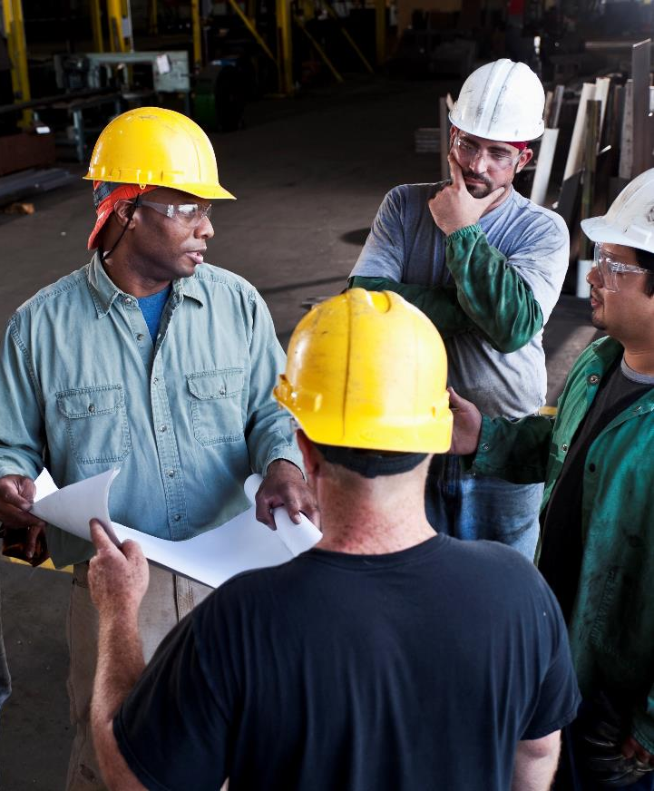
WHAT IS SAFETY LEADERSHIP?
Safety leadership does not have to be a person in a leadership role.
Safety Leaders:
Exhibit personal safety behaviors
Inspire others
Adhere to safety protocols precisely
Speak up in a constructive way
Acknowledge employees working safely
Listen to employees’ safety concern
Notes:
Safety leadership does not have to be a person in a leadership role (Lead hand, Supervisor, Manager).
A safety leader is somebody who not only exhibits personal safety behaviors but inspires others to do the same. These are people who not only follow safety protocols precisely but speak up in a constructive way when they see that others could be doing something in a safer manner. They acknowledge employees working safely and take time to listen to employees’ safety concern.
Having additional safety leaders results in more sustained, consistent and positive safety performance and behaviors.

Slide 18
GLOBAL SAFETY STAND DOWN 2023
Root Cause Analysis
Why is it important to determine root cause?
Fix things
Move away from blaming people
Hold people accountable
Example:
Incident: Received a speeding ticket
Why?
  Caught speeding
Why?
  Late for work
Why?
  Overslept
Why?
  Alarm clock didn’t work
Why?
  Dead batteries
Why?
  Didn’t change batteries
Solution: Plug in alarm clock
or replace batteries before they run out.
Step up for Safety
18
Notes:
When incidents happen, it is easy to lay blame on the specific circumstances and individual involved but most safety incidents have more than one attributing factor. When we examine incidents to discover root causes, we realize there are many opportunities to accept responsibility and effect change. A change in behavior or circumstances at any level of the root cause analysis, could have prevented the incident in question.
When we all accept responsibility for creating the environment or circumstances that facilitated an incident, we can effectuate meaningful change that ensures a safe workplace for everyone.

Slide 19
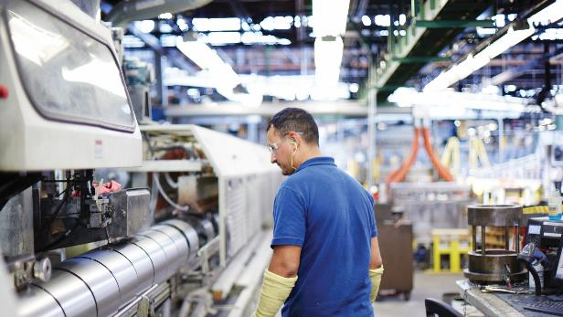
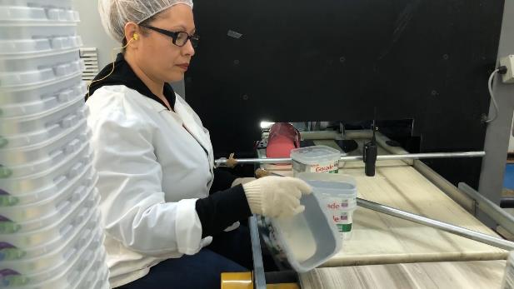
GLOBAL SAFETY STAND DOWN 2023
Everyone is responsible for safety
Follow procedures
Take ownership
Your right to stop work and report
Intervene if actions or environment seem unsafe
Ask questions to determine if situation is unsafe
Report to a manager or supervisor
Safety is Personal – Bring it to work, take it home!
Step up for Safety
19
Notes:
While the building of a safety culture begins with leadership, everyone has a responsibility for the safety of ourselves and those around us. Each one of us shares the responsibility of making sure everyone goes home safe every day. We can achieve this by following the safety procedures that are in place and taking personal ownership for ensuring safety is the first element in every decision we make.
Every employee has the right and responsibility to stop work and report unsafe conditions or actions. Any employee can intervene and has the right to request an operation or activity be stopped if they believe a situation is unsafe and employees are at risk. If you are not sure, you should at report the situation to a supervisor or manager. If your “gut” is telling you something is unsafe, then it probably is.
Safety is personal. So personal that you take it take it home. When you are mowing the lawn or hanging Christmas lights, what safety example are you setting for your neighbors or kids? No matter where you are or what you are doing, safety matters.

Slide 20
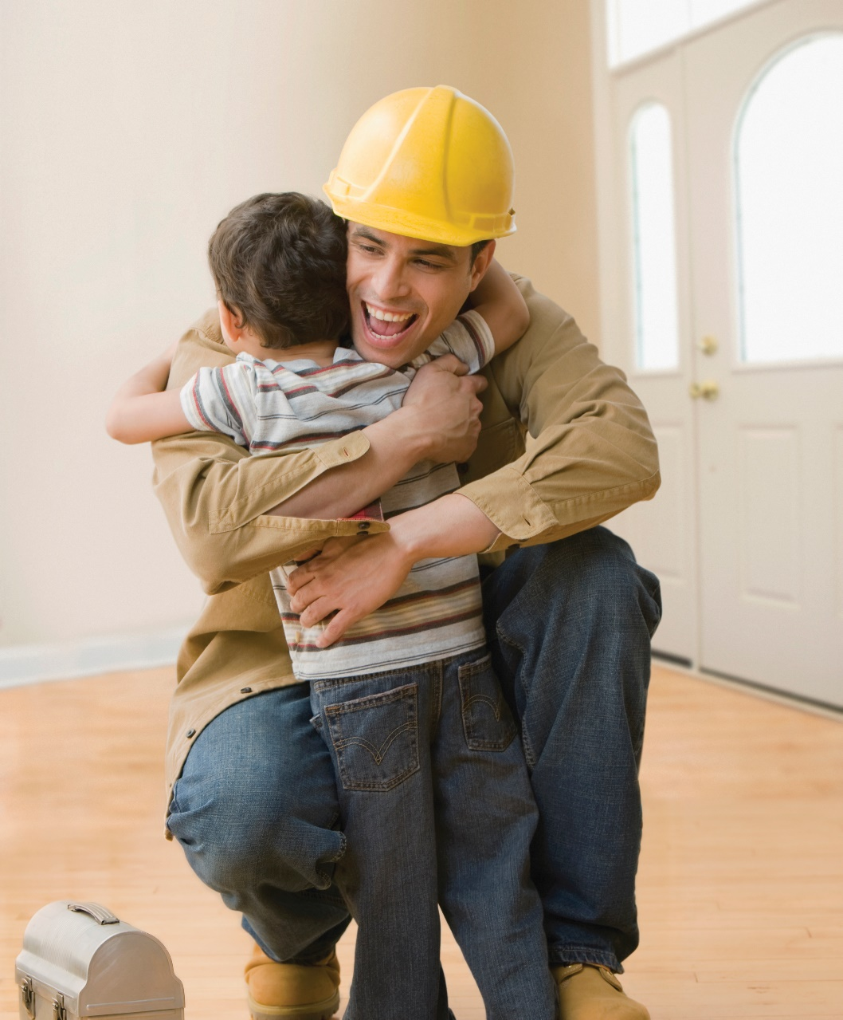
GLOBAL SAFETY STAND DOWN 2023
What actions will YOU take?
It’s time to…
“Step up for Safety”
Step up for Safety
20
Notes:
Safety must be a commitment that is made by every employee everyday and we can all do something to improve our commitment to safety. Think about your work environment and action and make a commitment to improve or change something that will help keep you and your fellow employees safer.
You will never know the injury that is prevented when you practice safety leadership.
What actions will YOU take?

